Slide 1
Unit 2
Lists
Objectives
Upon completion you will be able to
Explain the design, use, and operation of a list
Implement a list using a linked list structure
Understand the operation of the List ADT
Explain Complex implementations: circular linked lists, doubly linked lists
Data Structures: A Pseudocode Approach with C

Slide 2
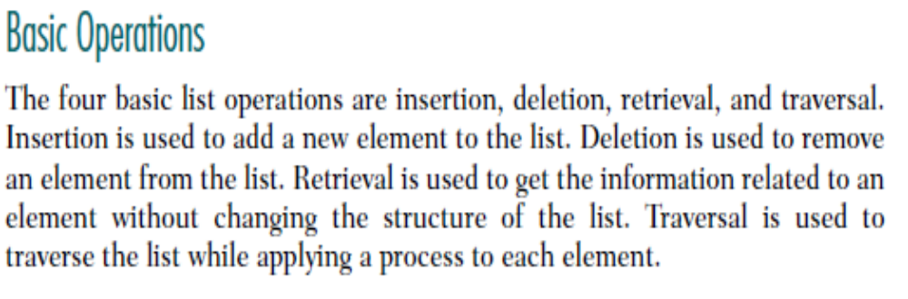
A general linear list is a list in which operations, such as retrievals, insertions, changes, and deletions, can be done anywhere in the list, that is, at the beginning, in the middle, or at the end of the list.
Data Structures: A Pseudocode Approach with C

Slide 3
Insertion
List insertion can be ordered or random.
Ordered lists are maintained in sequence according to the data or, when available, a key that identifies the data. A key is one or more fields within a structure that identifies the data.
Examples of keys: Social Security number and the universal product code on retail merchandise.
In random lists, also called chronological lists, there is no sequential relationship between two elements. They generally insert data at the end of the list.
Data Structures: A Pseudocode Approach with C

Slide 4
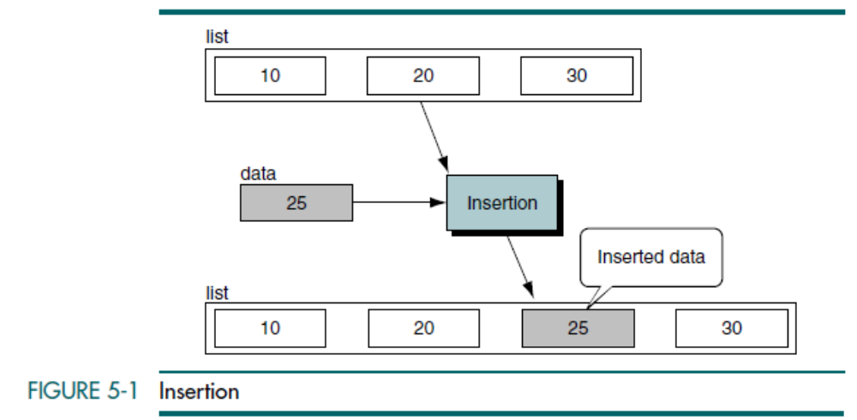
Insertion in Ordered List
Data Structures: A Pseudocode Approach with C

Slide 5
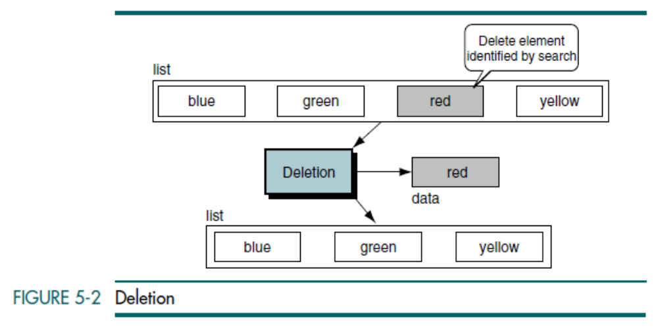
Data Structures: A Pseudocode Approach with C

Slide 6
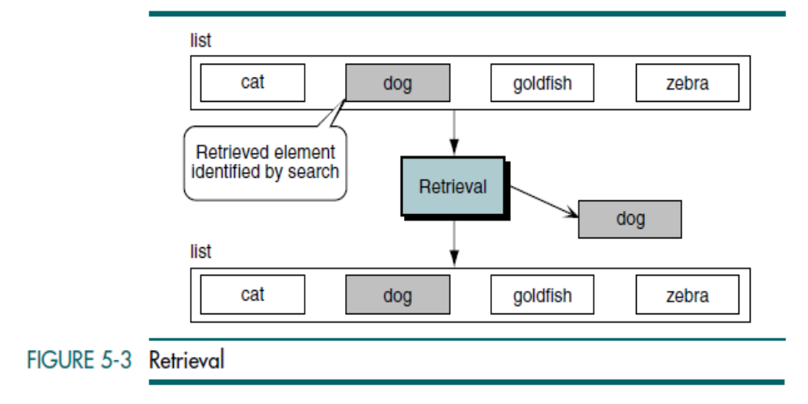
Data Structures: A Pseudocode Approach with C

Slide 7
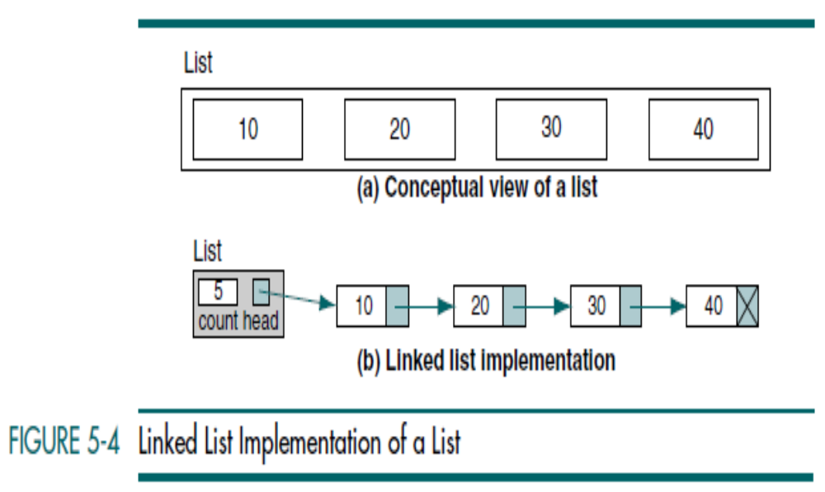
Data Structures: A Pseudocode Approach with C

Slide 8
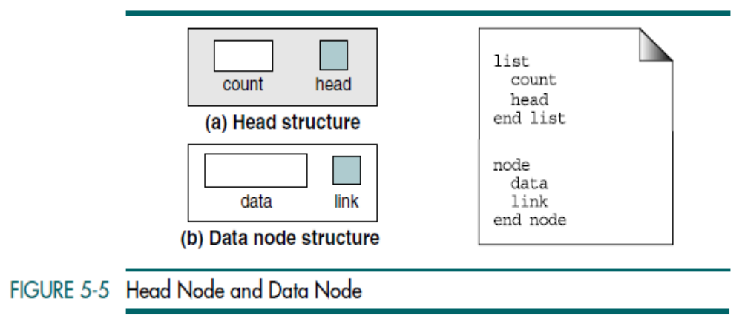
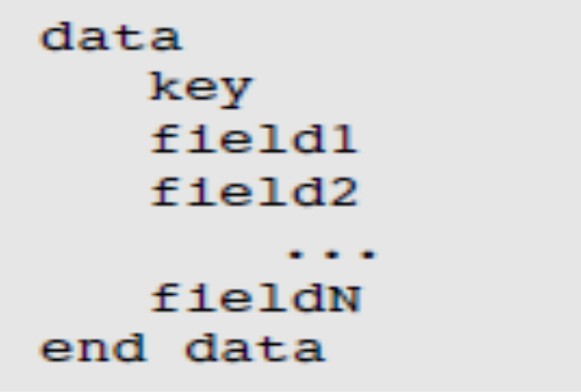
Data Structures: A Pseudocode Approach with C

Slide 9
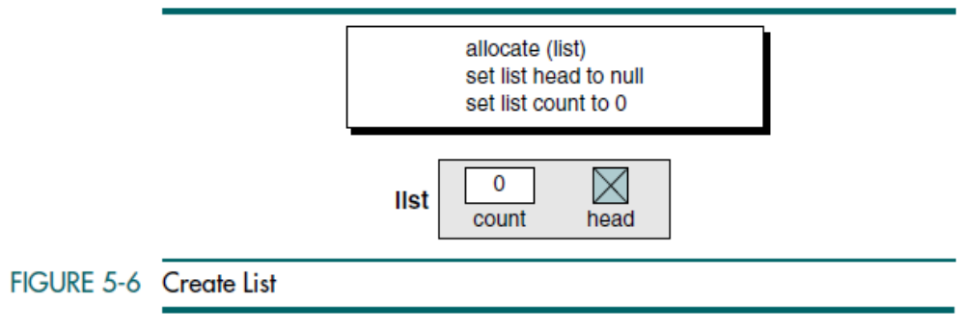
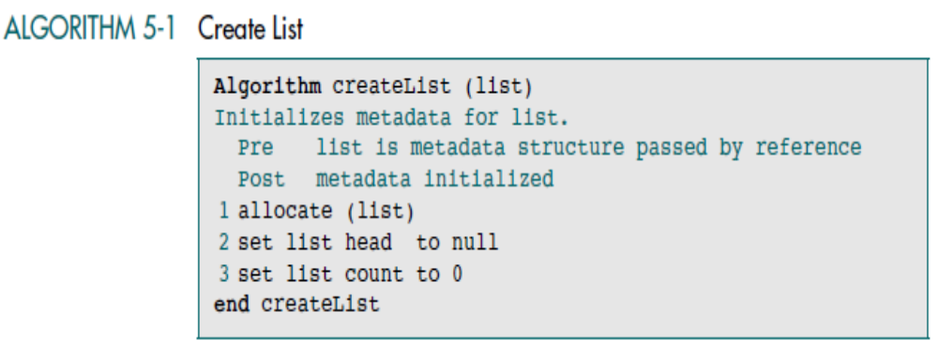
Data Structures: A Pseudocode Approach with C

Slide 10
Insert Node
Insert node adds data to a list. We need only its logical predecessor to insert a
node into the list. Given the predecessor, there are three steps to the insertion:
  1. Allocate memory for the new node and move data to the node.
  2. Point the new node to its successor.
  3. Point the new node’s predecessor to the new node.
Predecessor pointer –
it can contain the address of a node – middle of the list or at the end of the list
OR
it can be null – to an empty list or are at the beginning of the list.
Data Structures: A Pseudocode Approach with C

Slide 11
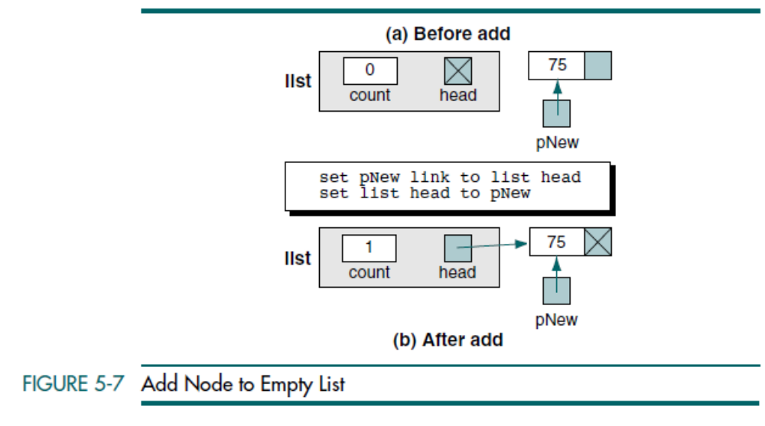
Data Structures: A Pseudocode Approach with C

Slide 12
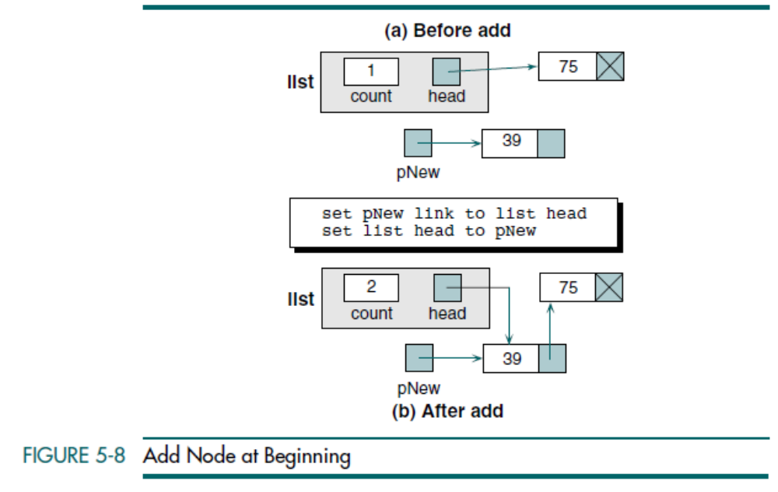
Data Structures: A Pseudocode Approach with C

Slide 13
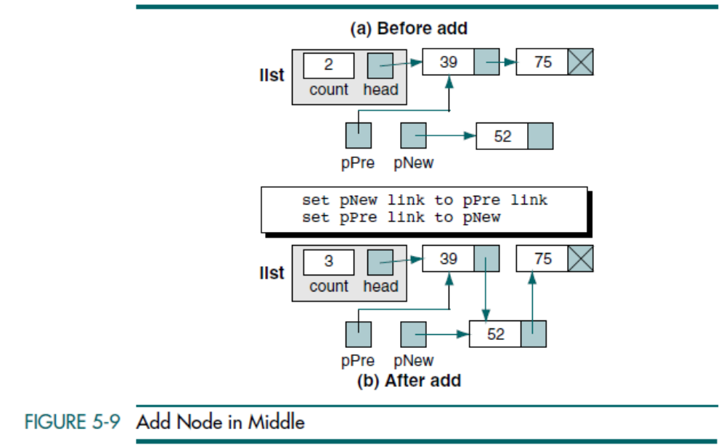
Data Structures: A Pseudocode Approach with C

Slide 14
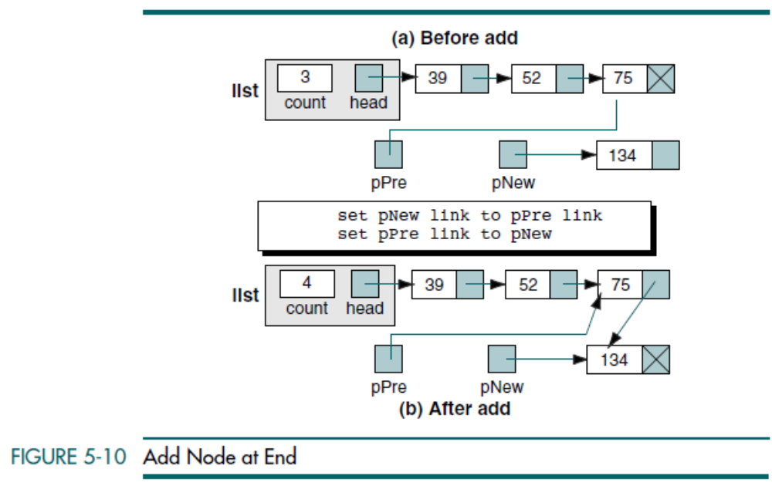
Data Structures: A Pseudocode Approach with C

Slide 15
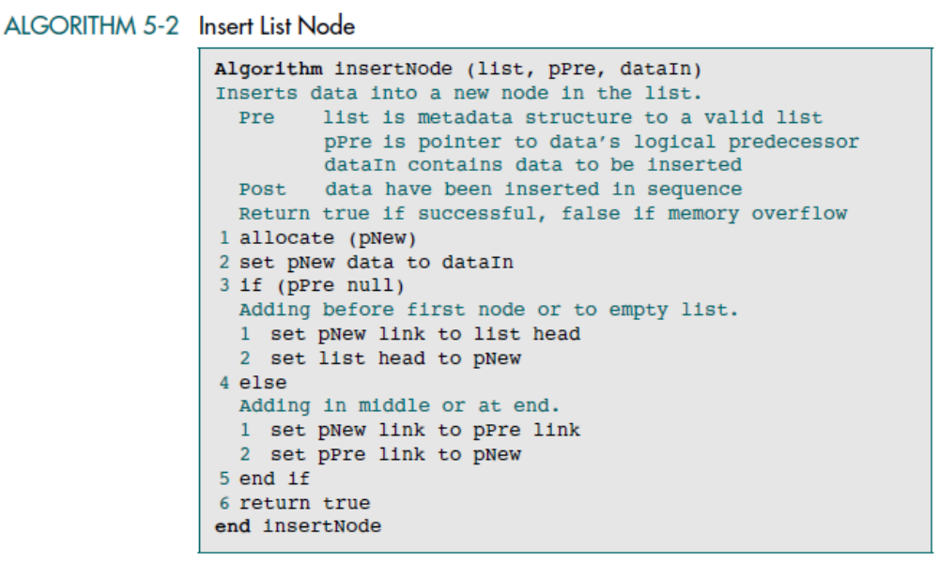
Data Structures: A Pseudocode Approach with C

Slide 16
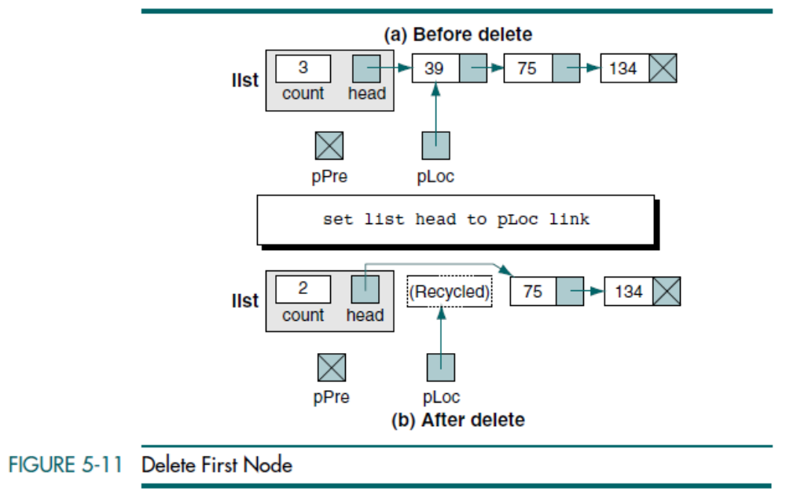
Data Structures: A Pseudocode Approach with C

Slide 17
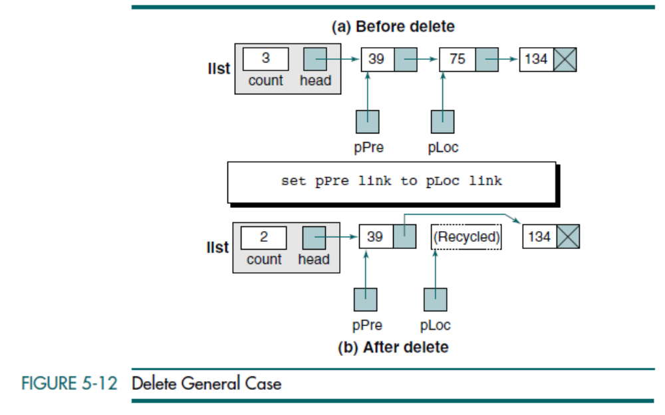
Data Structures: A Pseudocode Approach with C

Slide 18
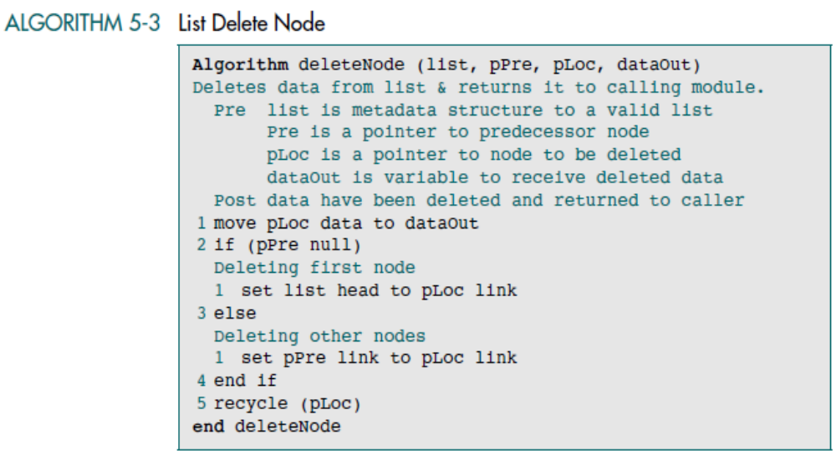
Data Structures: A Pseudocode Approach with C

Slide 19
Ordered List Search
Data Structures: A Pseudocode Approach with C

Slide 20
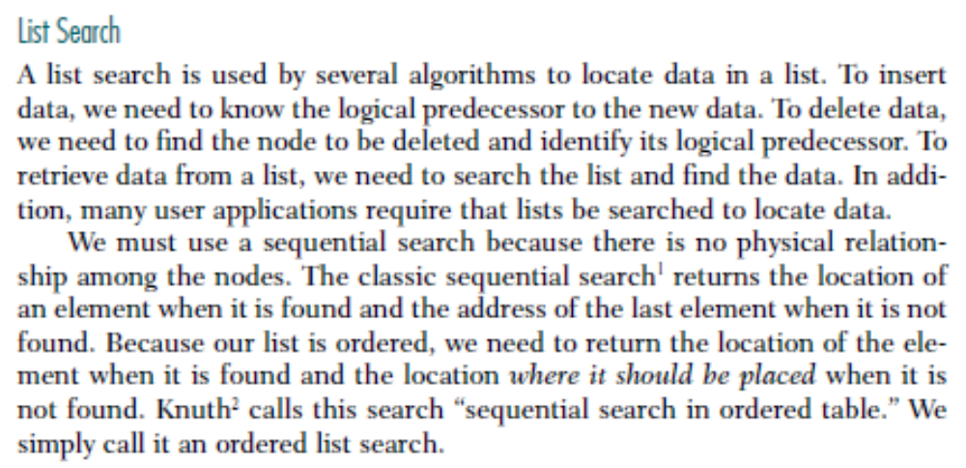
Ordered List Search
Data Structures: A Pseudocode Approach with C

Slide 21
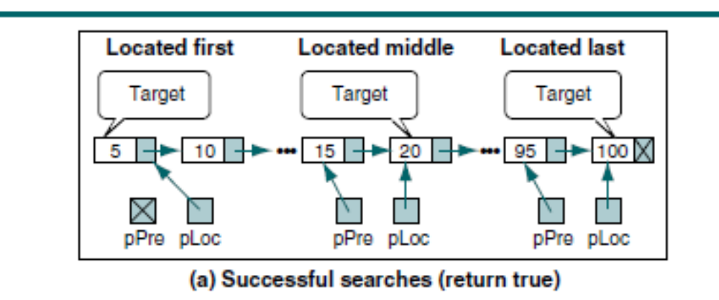
Data Structures: A Pseudocode Approach with C

Slide 22
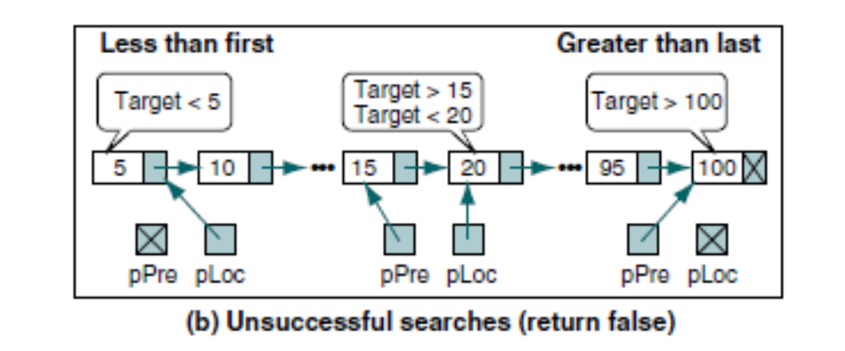
Data Structures: A Pseudocode Approach with C

Slide 23
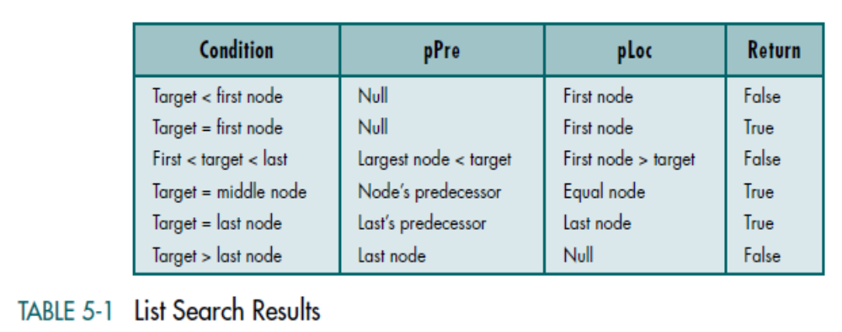
Ordered List Search
Data Structures: A Pseudocode Approach with C

Slide 24
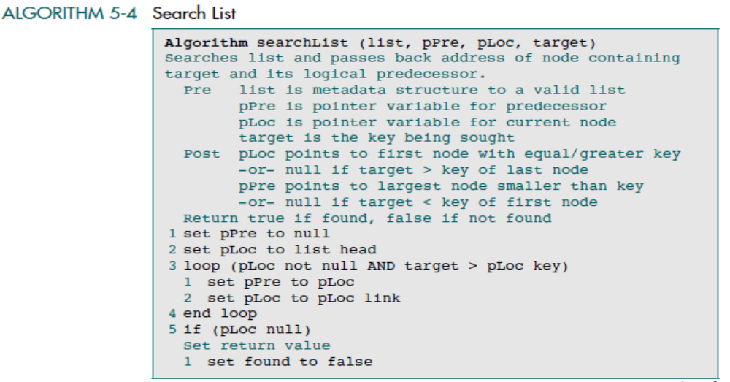
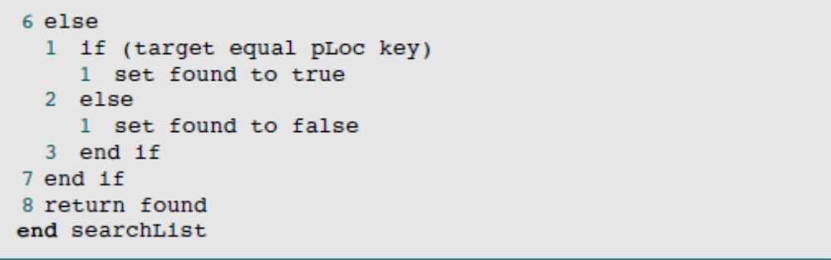
Data Structures: A Pseudocode Approach with C

Slide 25
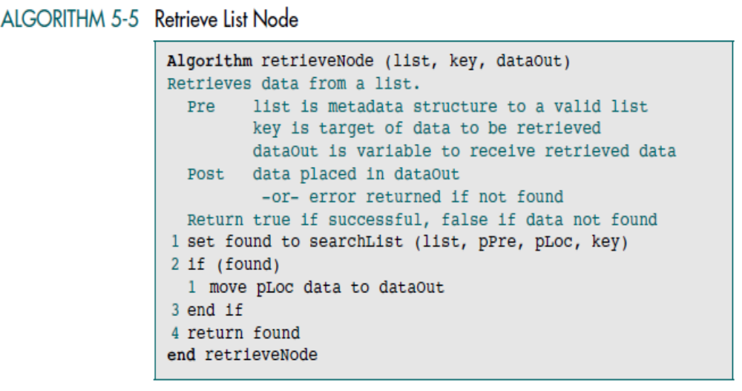
Data Structures: A Pseudocode Approach with C

Slide 26
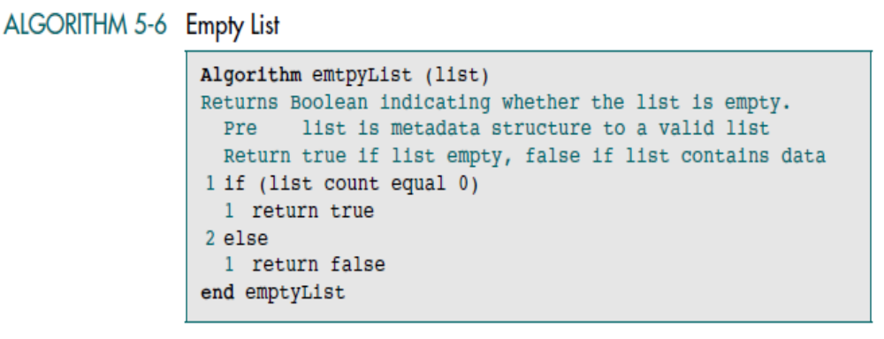
Data Structures: A Pseudocode Approach with C

Slide 27
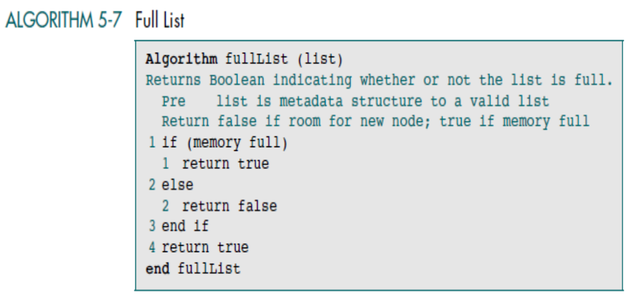
Data Structures: A Pseudocode Approach with C

Slide 28
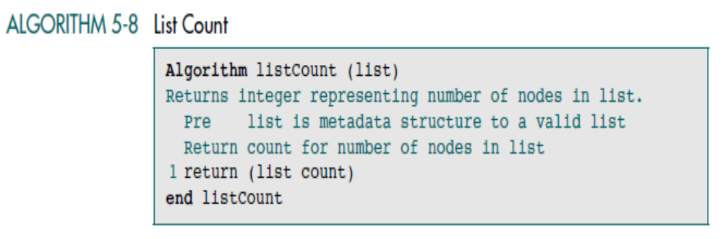
Data Structures: A Pseudocode Approach with C

Slide 29

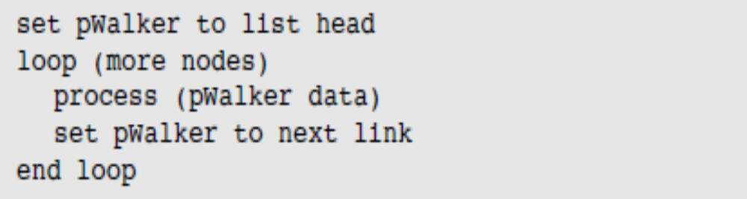
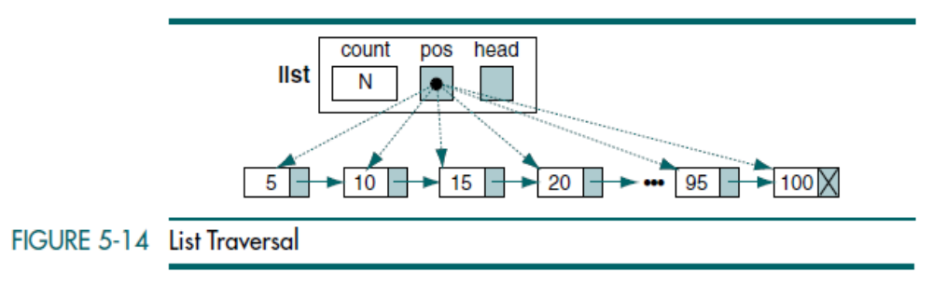
Data Structures: A Pseudocode Approach with C

Slide 30
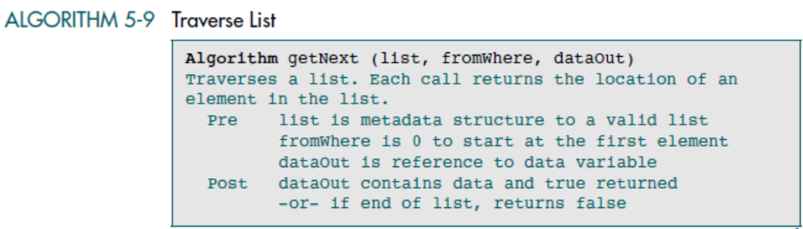
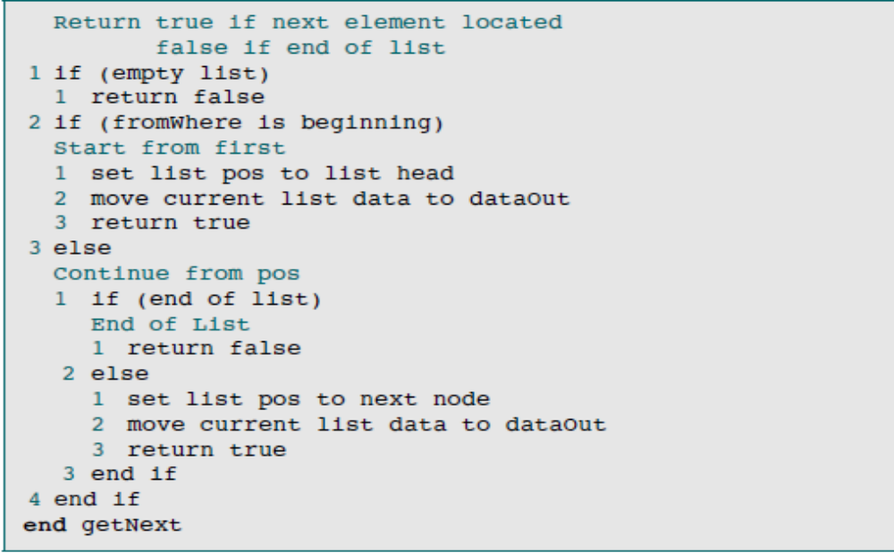
Data Structures: A Pseudocode Approach with C

Slide 31
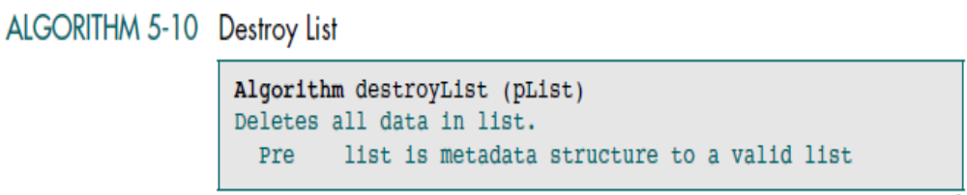
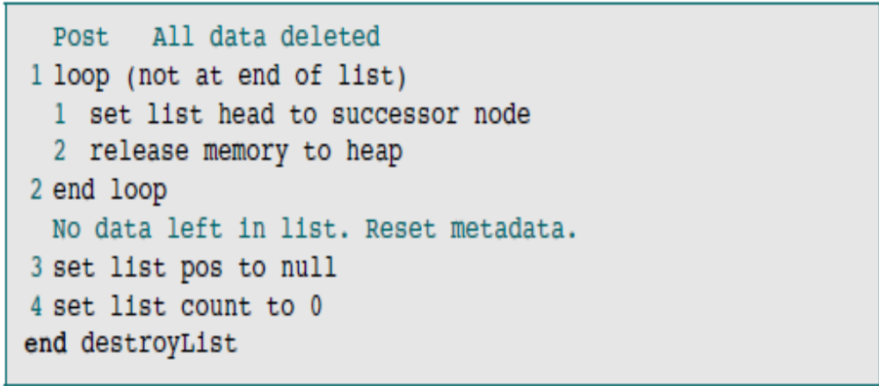
Data Structures: A Pseudocode Approach with C

Slide 32
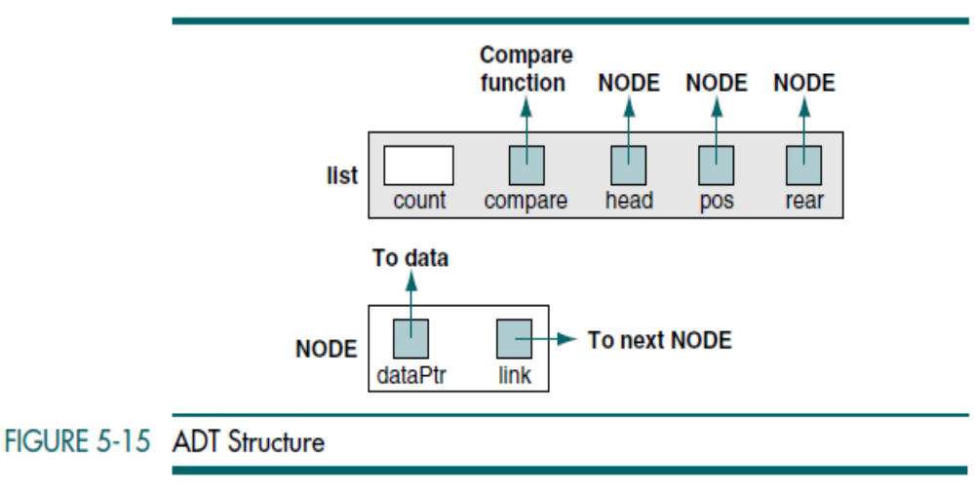
Data Structures: A Pseudocode Approach with C

Slide 33
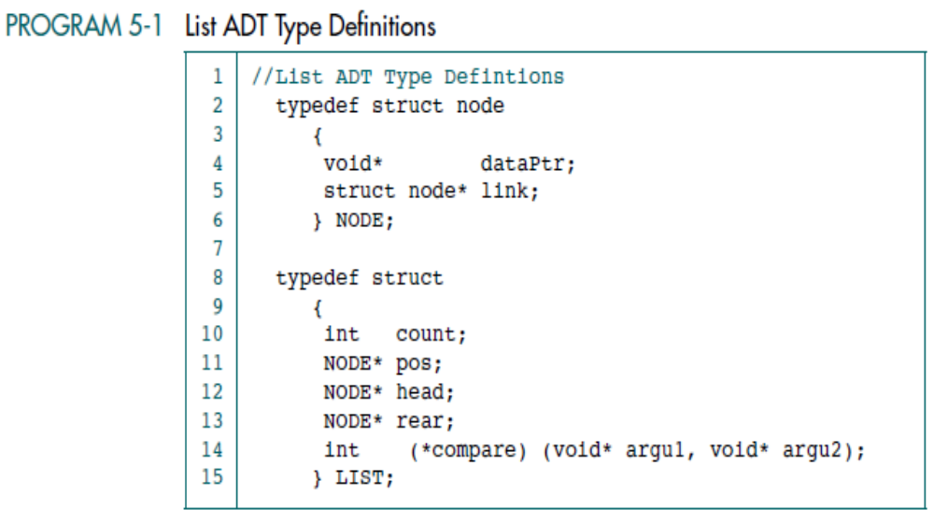
Data Structures: A Pseudocode Approach with C

Slide 34
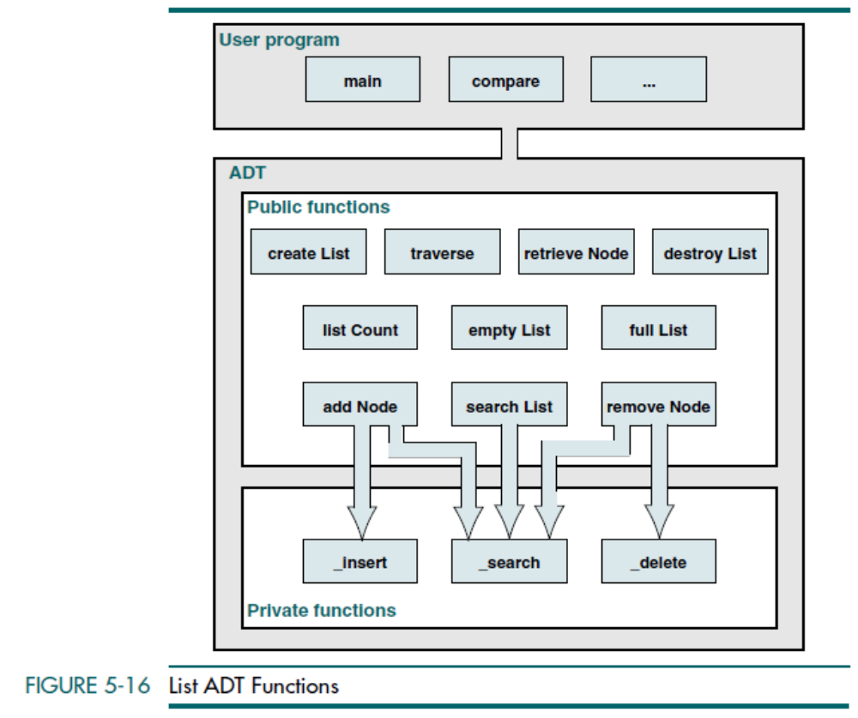
Data Structures: A Pseudocode Approach with C

Slide 35
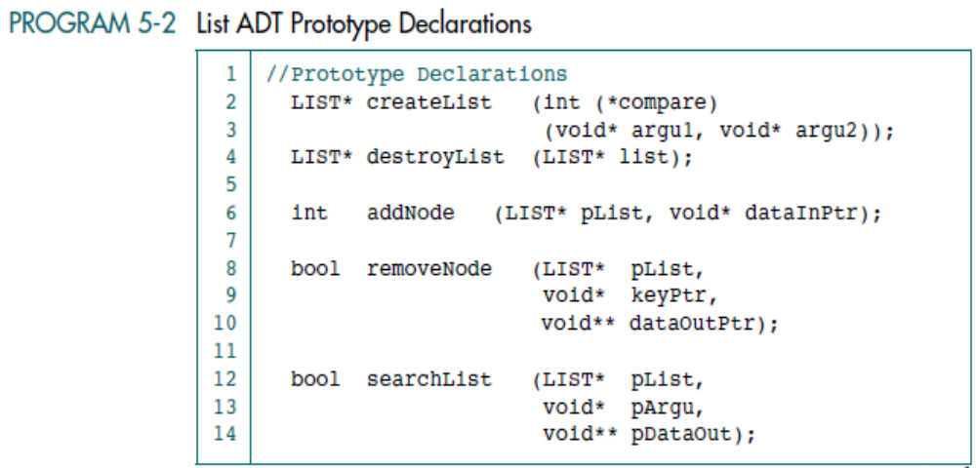
Data Structures: A Pseudocode Approach with C

Slide 36
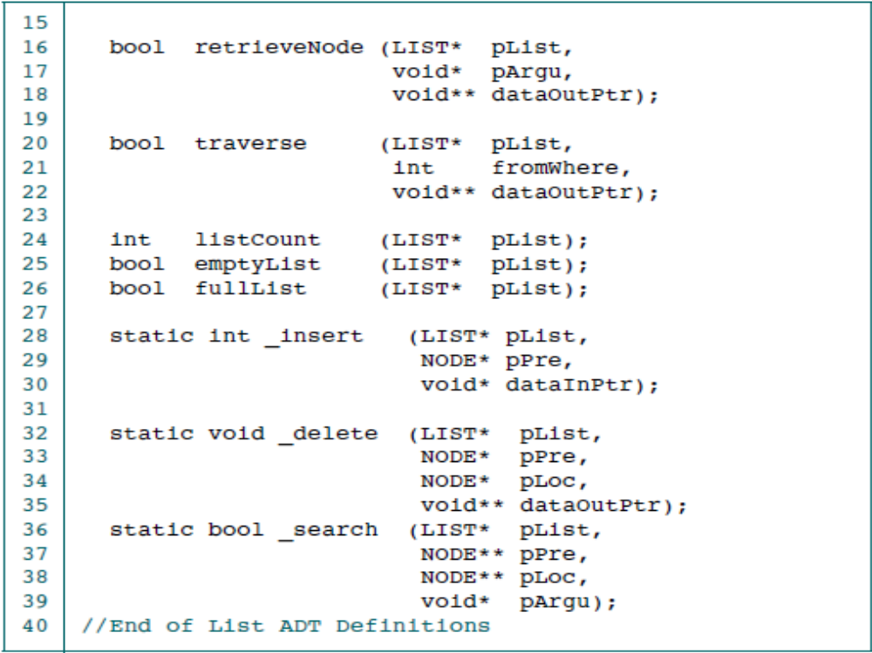
Data Structures: A Pseudocode Approach with C

Slide 37
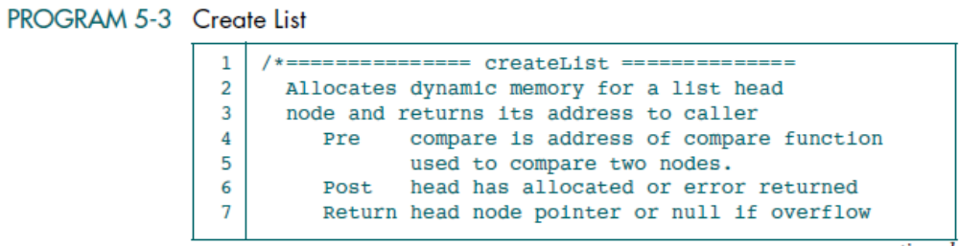
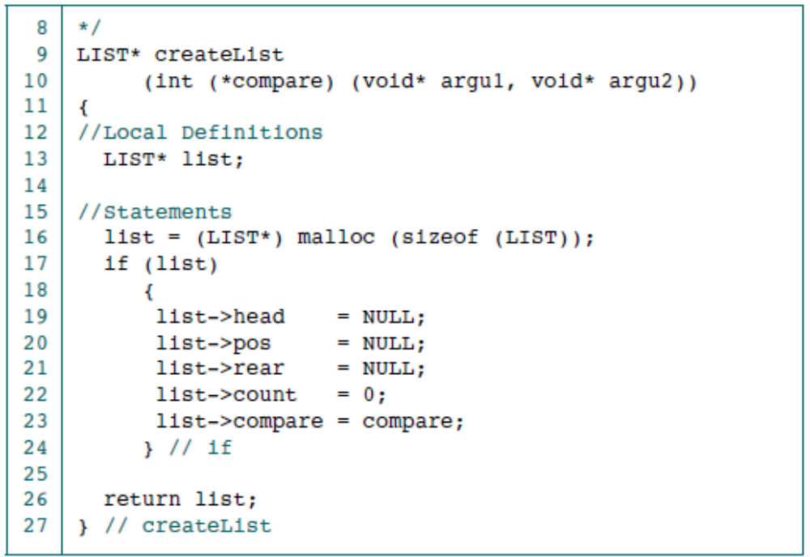
Data Structures: A Pseudocode Approach with C

Slide 38
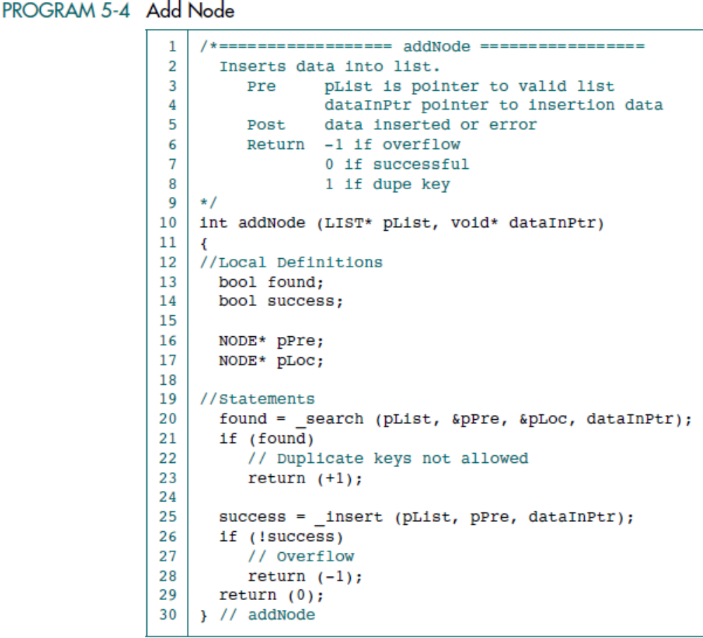
Data Structures: A Pseudocode Approach with C

Slide 39
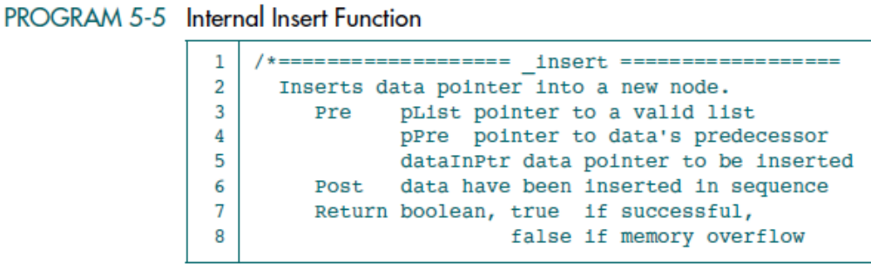
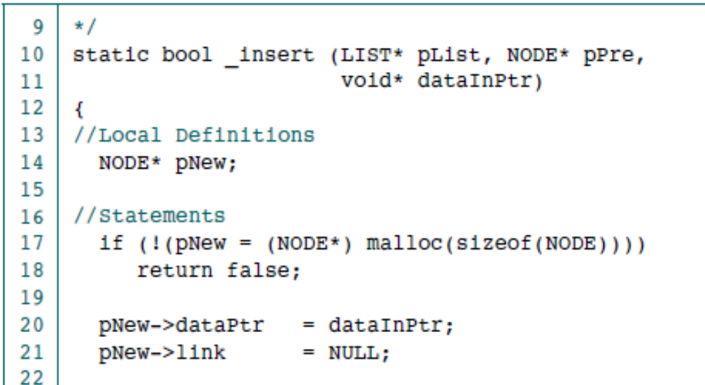
Data Structures: A Pseudocode Approach with C

Slide 40
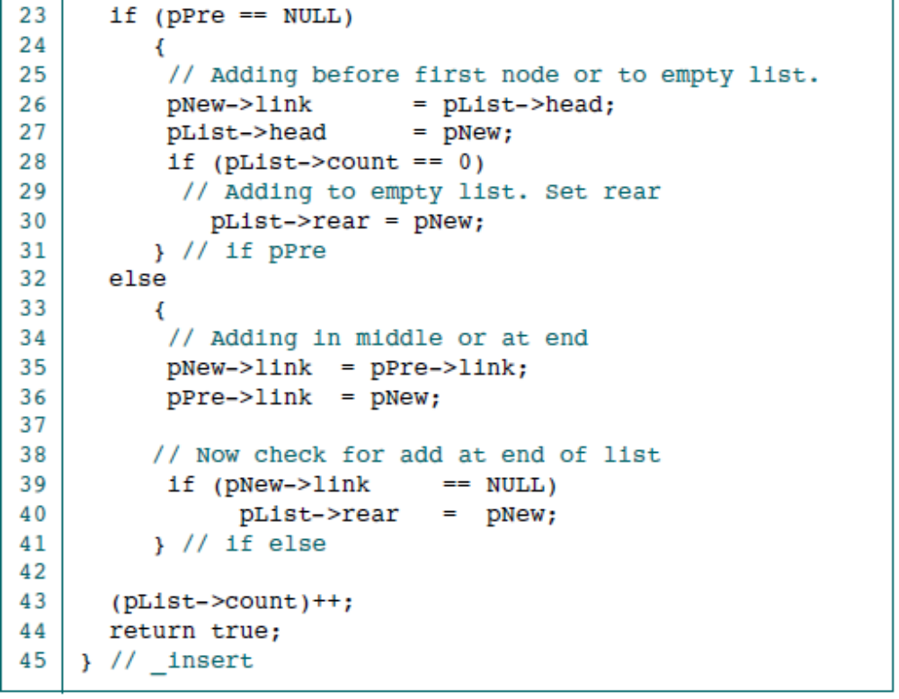
Data Structures: A Pseudocode Approach with C

Slide 41
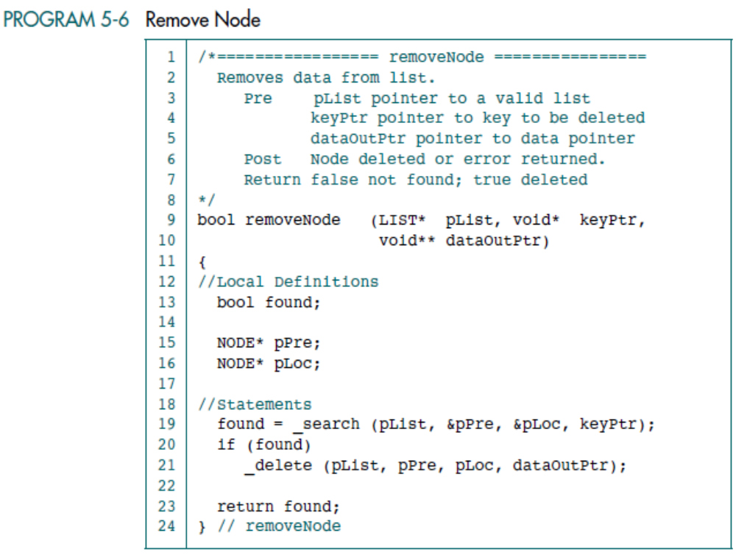
Data Structures: A Pseudocode Approach with C

Slide 42
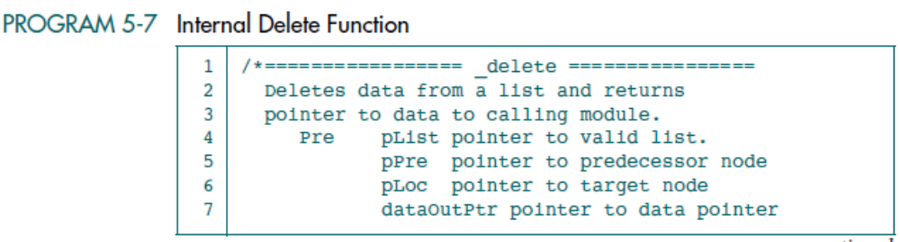
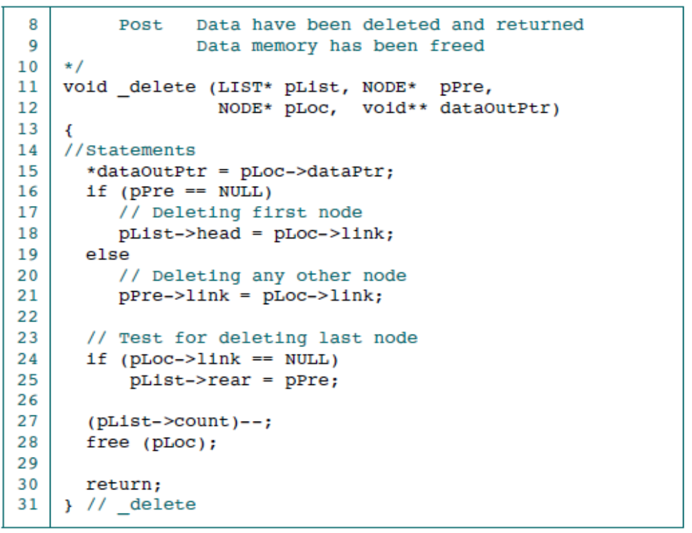
Data Structures: A Pseudocode Approach with C

Slide 43
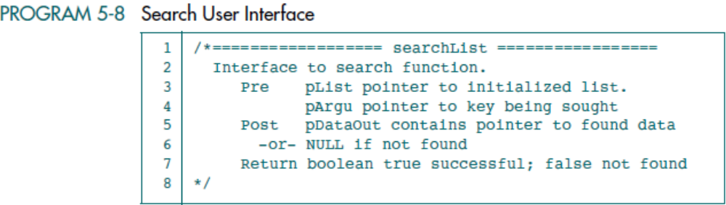
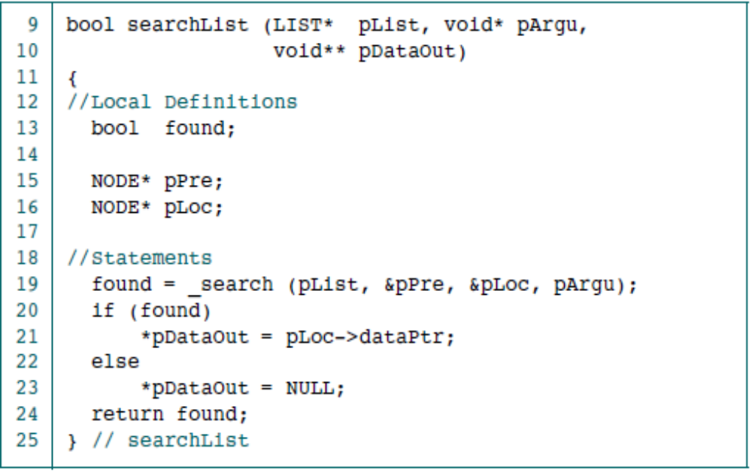
Data Structures: A Pseudocode Approach with C

Slide 44
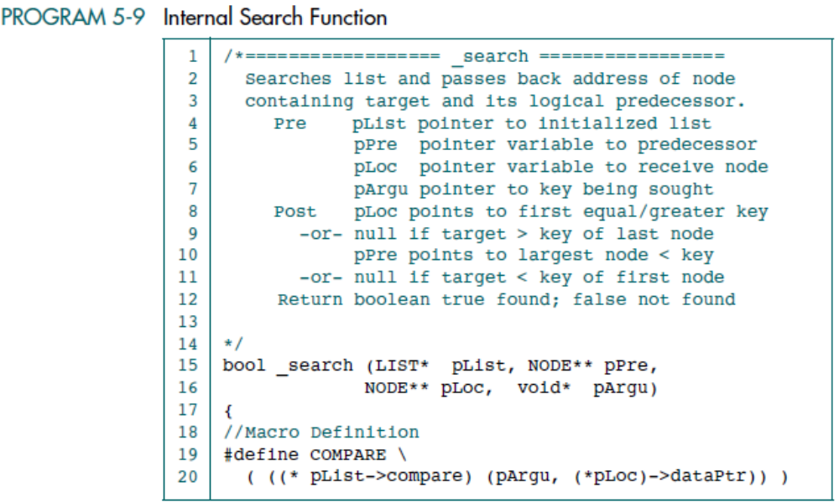
Data Structures: A Pseudocode Approach with C

Slide 45

Data Structures: A Pseudocode Approach with C

Slide 46

Data Structures: A Pseudocode Approach with C

Slide 47

Data Structures: A Pseudocode Approach with C

Slide 48


Data Structures: A Pseudocode Approach with C

Slide 49

Data Structures: A Pseudocode Approach with C

Slide 50


Data Structures: A Pseudocode Approach with C

Slide 51

Data Structures: A Pseudocode Approach with C

Slide 52

Data Structures: A Pseudocode Approach with C

Slide 53

Data Structures: A Pseudocode Approach with C

Slide 54


Data Structures: A Pseudocode Approach with C

Slide 55

Data Structures: A Pseudocode Approach with C

Slide 56

Data Structures: A Pseudocode Approach with C

Slide 57

Data Structures: A Pseudocode Approach with C

Slide 58

Data Structures: A Pseudocode Approach with C

Slide 59

Data Structures: A Pseudocode Approach with C

Slide 60

Data Structures: A Pseudocode Approach with C

